Slide 1
Affordable Care Act
Pub 4012 – ACA Tab
Pub 4491 – Lesson 3
Notes:
#9 – speaker notes updated
# 11 – clarify ESI
# 15 – speaker note added
# 28 – wording clarified when to claim code H
# 45 – added
# 46 – brought ahead of #47, note added
#51 - added
# 75 – clarified language
# 97 – moved up from 103
# 104 – added for Bogart calculator
# 124 – same as 46 now
# 135 – added speaker note
# 136 – revised to say don’t input 1095-A if not eligible for PTC
# 143 – added speaker note

Slide 2
Presentation Outline
Day 1
  Minimum Essential Coverage (“MEC”)
  Exemptions (core and comprehensive)
  Shared responsibility payment (“SRP”)
Day 2
  Premium tax credits (“PTC”)
  Comprehensive topics
Notes:
For new volunteers, it is recommended that the training be spread over two days
For returning volunteers, it is suggested that all the material be covered as a good refresher

Slide 3
Shared Responsibility for Health Coverage
Individuals
• Purchase coverage, Claim an exemption, or Pay Shared Responsibility Payment
• Account for premium credit (Day 2)
Government
• Expand Medicaid (at state option)
• Make premium tax credits available
• Build Marketplace(s)
Employers
• Large employers: provide coverage, and
• Small employers: incentives to provide coverage
Notes:
This lesson covers the individual provisions only

Slide 4
Three Main Elements
Everyone must have Healthcare Insurance
  Exemptions are available (Form 8965)
No Insurance and No Exemption?
  Additional tax - Individual Shared Responsibility Payment (“SRP”)
Financial Assistance
  Credit may be available (Form 8962)
Notes:
The training materials have been written in the above order.
It is recommended that they be taught in this order.

Slide 5
Intake & Interview
Complete the ACA section of the I&I form as much as possible
  Finish when return is finalized
If need an exemption, make initial determination on which exemption(s)
  Decide whether the return should be prepared by a more experienced counselor
Notes:
Emphasize to make lots of notes to document the TP’s responses and for the reviewer
Emphasize for the reviewer to finalize the notes and conclusions on the intake form

Slide 6
Intake & Interview
If MEC was purchased through the Marketplace, must have Form 1095-A
  Should be received by ~ 1/31/17
Screen for out-of-scope issues
  Shared policy or
  Alternative calculation for year of marriage
Notes:
1095-A filers have until January 31 to mail the form; it may take a few days for it to reach the taxpayer
Shared policies and alternative calculation discussed in day 2 lesson

Slide 7
Intake & Interview
Make notes of information received from the taxpayer on the Intake form
Finish the notes when the return is completed

Slide 8
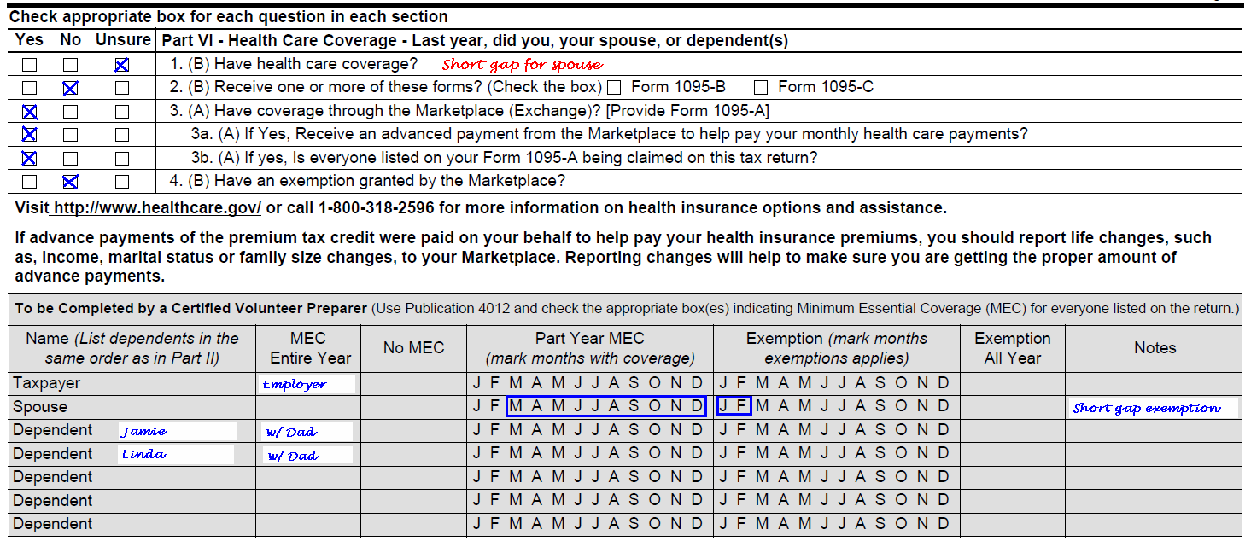
Intake & Interview 13614-C
Preparer and Reviewer notations sample:
Notes:
Shared policies discussed in Day 2

Slide 9
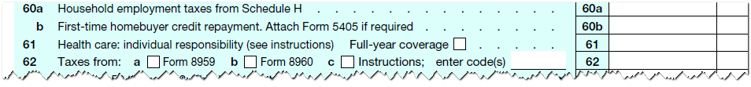
Coverage End Result:
Form 1040
Coverage or SRP – line 61
Never coverage and SRP
Not just any coverage – must be minimum essential coverage (MEC)
✓
Notes:
When it appears SRP will apply, the return should be reviewed by a “Master” in ACA
Apprentice Counselors may wish to refer the return to a more experienced preparer

Slide 10

What is Minimum Essential Coverage (MEC)?
Pub 4012 ACA-4
More than limited coverage, generally
  Pub 4012 p. ACA-4
  Pub 4491 p. 3-2 definition
95% of all Tax-Aide taxpayers had MEC for 2015
Can rely on taxpayer’s good faith representation – no need for proof
Notes:
Refer to ACA Tab in Pub 4012 for a complete list.

Slide 11
Types of MEC
Employer-sponsored insurance (“ESI”)
  Includes:
  Private and governmental employers, but not military
  Can be insured or self-insured
  Does not include:
  ESI is unaffordable or below minimum value and not taken
  Eligible because of relationship to employee offered ESI, but not included on that person’s tax return (e.g., non-dependent child under 26 or unmarried life partner)
Notes:
Foreign employer coverage is generally MEC
Emphasize that if ESI is taken, it is MEC and it doesn’t matter that it did not provide minimum value
Nonappropriated Fund Health Benefits Program of the Department of Defense program is both government-sponsored coverage and employer-sponsored coverage.

Slide 12
Types of MEC
Government-sponsored insurance (“GSI”)
  Includes:
  Medicare Part A or Advantage
  Most Medicaid, CHIP, TRICARE (military)
  Comprehensive VA
  Peace Corps, etc. (see Form 8965 instructions)
Notes:
Nonappropriated Fund Health Benefits Program of the Department of Defense program is both government-sponsored coverage and employer-sponsored coverage.

Slide 13
Types of MEC
Other HHS certified coverage
  Includes:
  Coverage available outside the U.S.
  Student health plans
Notes:
Coverage purchased from a foreign insurer may be MEC if recognized by Dept of Health & Human Services
Foreign government sponsored coverage may be MEC if recognized by Dept of Health & Human Services

Slide 14
Types of MEC
Individual market insurance
  Private or personal policy
  If purchased through the Marketplace or state exchange, it is a Marketplace policy
Notes:
Individual market insurance can be purchased directly from the insurance company or through an agency
The Health Insurance Marketplace offers many of the same policies that can be purchased directly

Slide 15
Does Taxpayer
Have MEC?
Rely on interview and on taxpayer’s good faith representation
May be exhibited by (but don’t need to see)
  Insurance card
  Form 1095-B – Health Coverage
  Form 1095-C – Employer-provided Insurance Offer and Coverage
  Other tax forms
Notes:
IRS has extended the due date for 1095-B until March 2, 2017

Slide 16
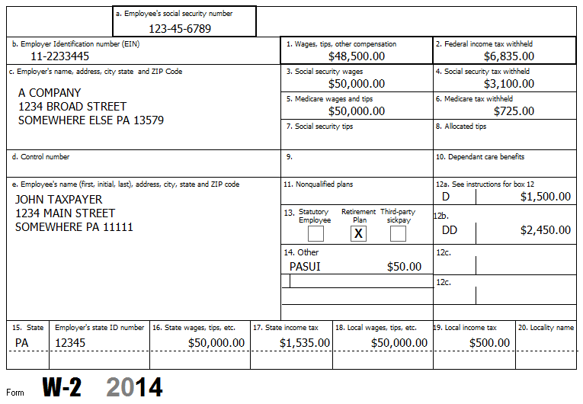
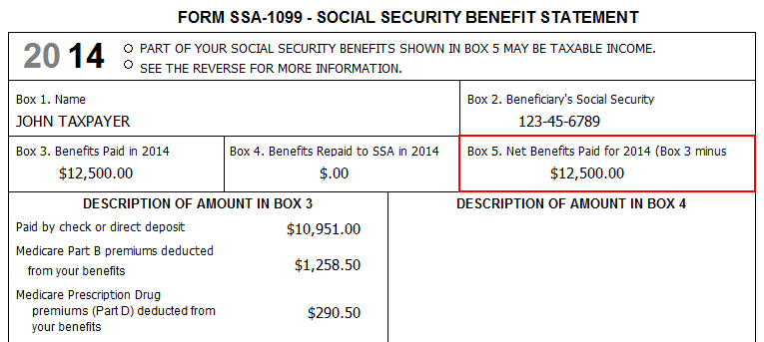
Other Tax Forms That Show MEC
Cost of employer-sponsored coverage
Medicare premiums deducted from benefits
Notes:
Note that Medicare Part A is MEC; if TP has Part B, normally will also have Part A

Slide 17
MEC Interview Questions
Pub 4012 ACA-4
Did you, your spouse and each dependent have Medicare, Medicaid, or other health insurance coverage all or part of the year? (See pub 4012 ACA-4)
  If not everyone, who did? who did not?
  If only part of the year which months were covered?
One day of coverage means that month is covered
Notes:
The requirement for this information from taxpayers needs to be communicated in advance.

Slide 18

Is This MEC?
Pub 4012 ACA-4
1. Sandy is covered under health insurance offered by her spouse's employer. Does she have minimum essential coverage?
Answer: Yes – Employer-sponsored coverage is minimum essential coverage

Slide 19
Is This MEC?
2. Peter's employer has a health plan that is "grandfathered." Is Peter's employer's health plan minimum essential coverage?
Answer: Yes – Grandfathered group health plans are minimum essential coverage

Slide 20
Is This MEC?
3. James is retired and too young to be eligible for Medicare. He received his health coverage through a retiree health insurance plan offered by his former employer. Is the retiree plan minimum essential coverage?
Answer: Yes – Retiree health plans are minimum essential coverage

Slide 21
Is This MEC?
4. Valerie is a local government employee and she enrolls in group health insurance coverage offered by her employer. Does she have minimum essential coverage?
Answer: Yes – Employer-sponsored coverage is minimum essential coverage regardless of whether the employer is a governmental, nonprofit, or for-profit entity
Notes:
Do not confuse “government” (the employer) with government-sponsored coverage, such as Medicare, Medicaid, TRICARE, VA comprehensive and CHIPS
Military members are covered by TRICARE

Slide 22
Who is Responsible for Coverage?
Every Taxpayer!
  For self, spouse and dependents
  Collectively, the “Tax Family”
    The definition is in Form 8965 instructions (and Pub 4491 p. 3-21)
Notes:
Discuss: Who is a taxpayer?
Person subject to the internal revenue laws – that is, required to file a return or actually files a return to claim a refundable credit
Filing just to get withholding or estimated payments back does not make a taxpayer

Slide 23
Who is Responsible for Coverage?
Dependent that could be claimed by more than one taxpayer
  Taxpayer with the higher priority in the tie-breaker rules is responsible for coverage

Slide 24
Who is Responsible for Coverage – Unclaimed Dependent
Counselors do not need to list the could-be dependent on the return nor claim an exemption for them
Notes:
Counselors do not need to list the could-be dependent on the return nor claim an exemption for them

Slide 25
Who is Responsible for Coverage?
5. Stevie is 20 years old, in school and claimed as a dependent by his parents
He also has a part-time job and will file a return
Who is responsible for Stevie’s coverage?
Answer: Stevie’s parents are responsible for Stevie’s MEC because they can claim him as a dependent

Slide 26
Who is Responsible for Coverage?
5. (cont.) What if Stevie’s parents do not claim him as their dependent, even though they could?
Answer: Stevie’s parents are not liable for SRP if Stevie does not have coverage
And, Stevie does not claim his own exemption so he is not responsible for his own MEC

Slide 27
Who is Responsible for Coverage?
6. Bob’s ex-wife gave him an 8332 so he can claim their child, Jenny, for tax purposes even though Jenny does not live with Bob
Who is responsible for Jenny’s coverage?
Answer: Bob is responsible for Jenny’s MEC because he will claim her as his dependent

Slide 28
When is Coverage Needed?
Count full months lived for births or deaths*
Count full months following month of adoption*
* See exemption code H later when someone on the return needs another exemption
Notes:
If newborns/adoptees or decedents had coverage for the full months they lived with the tax family and everyone else on the return had coverage for the full year, then everyone had the coverage they needed and no exemption is needed

Slide 29
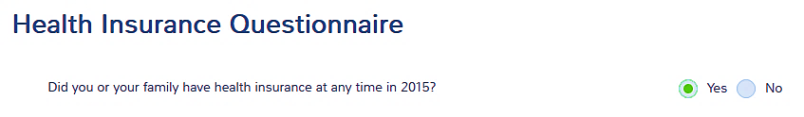
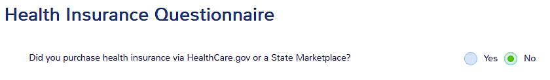
When Everyone Has
MEC All Year (not Mkt policy)
A few quick clicks in TaxSlayer Health Insurance section
  Any coverage? - yes
  From Mkt? - no
Notes:
Seniors on Medicare generally fall in this scenario

Slide 30
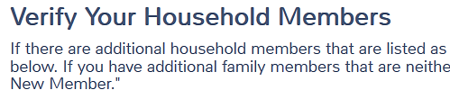

When Everyone Has
MEC All Year (not Mkt policy)
  Verify – just click continue (do not add anyone)
  All months? - yes
Notes:
Remind students that this the case 95% of the time! (91% across all VITA/TCE)

Slide 31



When Everyone Has
MEC All Year
  Confirm result on Summary / Print – page 2
  Box will be checked on Line 61 – done!
Notes:
Remind students that this the case 95% of the time! (91% across all VITA/TCE)

Slide 32
Now It Gets a Little Complicated
When any individual on the return lacks MEC for any full month
  Which months?
  Is there an (easy) exemption?
  If not, should a more experienced counselor prepare the return?

Slide 33
Now It Gets a Little Complicated
When any individual on the return lacks MEC for any full month
  Need answers before completing TaxSlayer questions
Step 1: look for an exemption that applies
Notes:
TaxSlayer processes all exemptions at the same time
Students need to determine the answers and only then enter into TaxSlayer

Slide 34
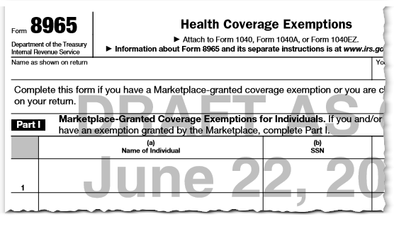
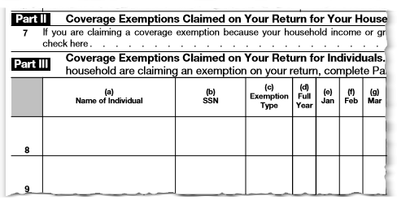
Exemption Form 8965
Part I for Marketplace exemptions
Part II for filing threshold exemption
Part III for individual exemptions claimed on return
Notes:
Instructions for form 8965 provide detailed information for completing the form

Slide 35
Who needs an exemption?
Pub 4012 ACA-5
Any individual on the tax return who did not have MEC for one or more months during the tax year
Notes:
Students should find the box in 4012 page ACA-2 that covers this material

Slide 36
Types of Exemptions
Pub 4012 ACA-7
Exemptions that can be claimed on the tax return
Exemptions that can be requested from the Marketplace
  Some are prospective; some can be retrospective
Notes:
This lesson addresses the tax return exemptions
See list of hardship and other marketplace exemptions on pub 4012 ACA-7

Slide 37
Types of Exemptions
Some exemptions cover everyone on the return; some cover the particular individual only
Some exemptions are good for the whole year; some cover specific months
Exempt for one day means exempt for the whole month!

Slide 38
Pub 4012 ACA-7
Does the taxpayer already have an exemption from the Marketplace or have an application pending?
How to start:
NO
Does the taxpayer have income below the filing threshold?
Applies to the entire household for the entire year.
NO
Exemptions for individuals (duration varies):
Short coverage gap | Code B
Resided in Medicaid non-expansion state | Code G
Certain noncitizens and citizens living abroad | Code C
Health care sharing ministry | Code D
Federally-recognized Indian tribe or eligible for IHS | Code E
Incarceration | Code F
Member of household born, adopted or died | Code H
Insurance is unaffordable | Code A
Aggregate cost of insurance is unaffordable | Code G
NO
Does anyone qualify for a Marketplace hardship exemption?
Notes:
Start with Marketplace exemptions – TP may already have an exemption
Will go through all the exemptions in turn

Slide 39
Is there a Marketplace
Exemption?
First, ask if taxpayer already has an exemption from the marketplace
Marketplace Exemptions may exempt one or more individuals for some or all months of the year
  Taxpayer provides their marketplace exemption certificate number (“ECN”) letter
  If not yet received, use “PENDING”
Less than ½ of 1% had a Mkt exemption in 2015 across all VITA/TCE
Notes:
Students should review types of exemptions that Mkt can grant in Pub 4012

Slide 40
Is there a Marketplace
Exemption?
Marketplace is no longer issuing these exemptions
Previously issued Mkt exemptions can be used for 2016
Health care sharing ministry
Indian tribe members
Incarceration

Slide 41
Is there an Exemption?
Second, start with exemptions that can be claimed on tax return
  Simpler than applying for Marketplace exemptions
  But note that some Marketplace exemptions can be granted retroactively
Notes:
Screening individuals for an exemption, if needed, will be an important part of the counselor interview.
Tax-Aide is not a Navigator or other in-person assister but we can provide assistance in possible exemptions that the taxpayer can pursue.

Slide 42
Filing Threshold Exemption
Pub 4012 ACA-8
Does the taxpayer have income below the filing threshold?
Applies to the entire household for the entire year.
Two filing threshold exemptions
  One for household income
  The other for taxpayer’s gross income
Just one question on the form
Notes:
This is a forms change for TY 2016

Slide 43
Filing Threshold Exemption – Household Income
Household income below filing threshold, where household income =
Include MAGI of claimed dependents required to file a return due to gross income
MAGI
Adjusted Gross Income
(AGI)
Tax-Exempt Interest
Excluded Foreign Income
=
+
+
Form 1040, Line 37
Form 1040, Line 37
Form 1040, Line 8b
Form 2555 or 2555-EZ
Notes:
We’ll refer to this as “Household Income A”
Highlight that there are various MAGI in the tax code
Over 7% of the returns filed by VITA/TCE claimed a filing threshold exemption for 2015

Slide 44
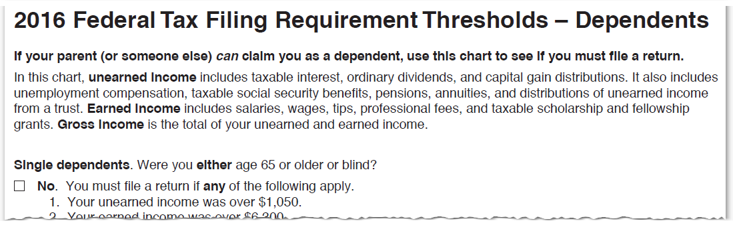
Dependent Filing Requirement
Pub 4012 ACA-9
Dependent required to file due to gross income only
Notes:
So a dependent that needs to file to pay self-employment tax is not automatically included
The dependent’s gross income must exceed the filing threshold
A dependent’s income comes into play in several instances for ACA
Emphasize that for each and every instance, only when the dependent’s gross income exceeds the filing threshold
If the dependent is not in fact claimed, then do not include the dependent’s income in any instance

Slide 45
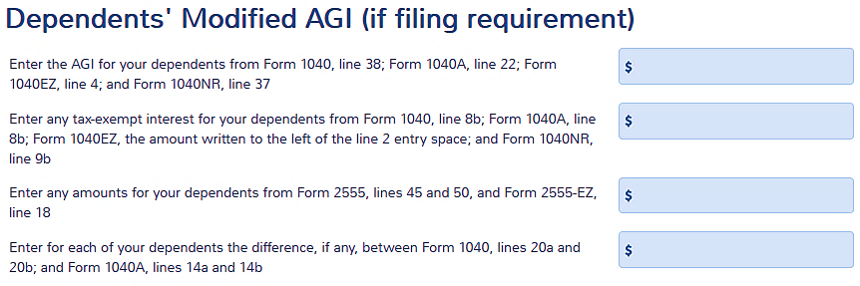
Dependent Income in TaxSlayer
TaxSlayer has “Promised” for 2016
Need to add all dependents’ amounts from their returns
Notes:
Early TaxSlayer information is that this screen will be earlier in the Health Insurance section.

Slide 46

Household Income for
Filing Threshold Exemption
If prior slide not implemented by TaxSlayer
To manually compute Household income
  Start with AGI on the return – 1040 line 37
  Add back exempt interest income, line 8b
  Add back excluded foreign income, if any
Determine dependents’ filing requirement and compute their MAGI
Add all together and compare to filing threshold for taxpayer
Notate the calculation on the intake sheet for the reviewer
Notes:
This step may not be needed if the prior slide is implemented for the filing threshold exemption
Assuming the prior slide is implement, TaxSlayer should make this calculation and claim the exemption automatically
Emphasize that these calculations are made after all other entries are entered into TaxSlayer

Slide 47

Filing Threshold Exemption – Gross Income
Pub 4012 ACA-8
Tax return gross income below filing threshold
Do NOT include any dependent’s income
Notes:
Class should discuss what is in gross income and what is not

Slide 48
Gross Income for
Filing Threshold Exemption
To manually compute gross income
  Start with total income on the return – 1040 line 22
  Add back expenses shown on Sch C
  Add back losses shown on F 8949 or Sch D
    If grouped transactions, separate losses
  Any other adjustments?
Notate the calculation on the intake sheet for the reviewer
Notes:
These are the in-scope adjustments
Out-of-scope adjustments would includes expenses shown on Sch E or Sch F
Emphasize to make the calculation after all other entries are in

Slide 49
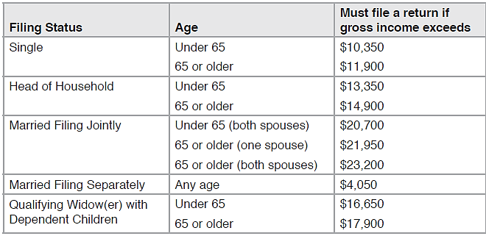
2016 Federal
Filing Thresholds

Slide 50
Filing Threshold Exemption
When a filing threshold exemption applies:
  EVERYONE on the return is exempted for the WHOLE year
  Can stop here; otherwise, continue to other exemptions

Slide 51
Affordability Calculator
cotaxaide.org/tools
Great tool – if used properly
  Read all line instructions carefully
Computes Household income/ Gross Income and tests for filing threshold exemption based on entries

Slide 52
Filing a Return to claim a Coverage Exemption
7. If Randy is not required to file a federal income tax return, does he need to file to claim an ACA exemption?
Answer: Randy does not need to file just to claim the ACA exemption. If he files a return anyway, he should claim a filing threshold exemption

Slide 53

Individual Exemptions
Claimed on Form 8965 Part III
Pub 4012 ACA-7
No need to memorize each exemption or type code
Refer to Pub 4012 p. ACA-7
Notes:
Over 6% of 2015 returns prepared by VITA/TCE claimed an exemption on the tax return in Part III

Slide 54
Short-Gap Exemption
Code B
Gap must be less than 3 consecutive months
  Exemption does not apply if gap is 3 months or more
  Look back (to 2015) but no need to look forward (to 2017)
If a month is covered by another exemption, it is treated as having coverage and that month is not a gap month
Notes:
Remember:
Coverage for one day = coverage for the full month
Exemption for one day = exemption for the full month

Slide 55
Short-Gap Exemption
Can use short-gap exemption only once per individual per year
If two short gaps, short-gap exemption applies to earlier gap
Can use another exemption for another gap or for adjacent months

Slide 56
Short Gap Exemption Example 1
Taxpayer:
claimed the short-gap exemption for Dec 2015
had no coverage Jan 2016 (and no other exemption)
had coverage Feb – Nov 2016
had no coverage Dec 2016 (and no other exemption)
Can use short-gap exemption for Jan 2016 as the total short gap is less than 3 months
Cannot use the short-gap exemption for Dec 2016 (only one short-gap exemption per year)
Notes:
If 2 or more short gaps, short gap is used on the first such gap
If earlier gap is covered by another exemption, can use short-gap exemption for second gap

Slide 57
Short Gap Exemption Example 2
Taxpayer:
had no insurance Dec 2015 – Feb 2016
claimed short-gap exemption for Dec 2015
had coverage Mar – Dec 2016
Even though only 2 months of gap in 2016, cannot use short-gap exemption for Jan - Feb 2016 as total gap is 3 months or more
Hint: If short-gap exemption might apply for January 2016, check the 2015 return!
Notes:
If a different exemption was used for Dec 2015, then the short-gap exemption could be used for Jan/Feb 2016.

Slide 58
Short Gap Exemption Example 3
Taxpayer:
had no insurance Jan – Jun 2016
was incarcerated* Jan – Apr 2016
Claim incarceration exemption for Jan – Apr (treated has having coverage)
Can claim short-gap exemption for May and June 2016
*See exemption chart – covered in a later slide
Notes:
Even if incarcerated for just one day, exemption is good for the month

Slide 59
Medicaid Nonexpansion
State Exemption Code G
At any time during 2016, resided (lived) in a state that did not expand Medicaid
Household income is less than 138% of FPL based on household size (using claimed dependents only)
If move into or out of a nonexpansion state and the test is met, the exemption applies for the full year
Notes:
Highlight if this applies to your state
These are the nonexpansion states for 2016: AL, FL, GA, ID, KS, LA (7/1/2016), ME, MO, MS, NC, NE, OK, SC, SD, TN, TX, UT, VA, WI, WY
Form 8965 draft instructions also include Alaska and Indiana as nonexpansion states for 2016

Slide 60
Medicaid Nonexpansion
State Exemption
“Household Income” includes
Untaxed SS refers to amount reported on SSA-1099 only (wholly-exempt SSI is not included)
Includes the income of claimed dependents who have a filing requirement
Adjusted Gross Income
(AGI)
Tax-Exempt Interest
Excluded Foreign Income
Untaxed Social Security Benefits
+
+
+
Form 1040, Line 37
Form 1040, Line 8b
Form 2555 or 2555-EZ
Form 1040, Line 20a - 20b
Notes:
We’ll refer to this as “Household Income B”

Slide 61
Medicaid NonExpansion State Exemption
Pub 4012 ACA-13
Is the taxpayer’s household income less than 138% of FPL?
  See FPL table in Pub 4012, p. ACA-12
Exemption applies for the full year to each individual who resided (lived) in a nonexpansion state at any time during the year
Notes:
It is not relevant whether the individual could have had other insurance, e.g. employer coverage, or whether they could have had PTC to help pay for coverage

Slide 62
Noncitizens or Citizen Living Abroad Exemption Code C
Not a U.S. citizen, not a U.S. national, and not lawfully present in the U.S.
  Includes DACA immigrants
Most often seen scenario for this exemption code
Notes:
Remind students that an ITIN does not necessarily mean that the individual is unlawfully present in the U.S.
DACA – Deferred Action for Childhood Arrivals – “Dream Act”
Allowed to stay in the U.S.
Still not lawful and eligible for the exemption

Slide 63
Noncitizens or Citizen Living Abroad Exemption Code C
Exemption applies also to:
A bona fide resident of a U.S. territory
A resident alien who was a citizen of a foreign country with which the U.S. has an income tax treaty with a nondiscrimination clause, and who was a bona fide resident of a foreign country for the tax year
Notes:
Remind students that an ITIN does not necessarily mean that the individual is unlawfully present in the U.S.
Unlikely that the second scenario will present itself at a Tax-Aide site

Slide 64
Noncitizens or Citizen Living Abroad Exemption
A U.S. citizen or resident who spent at least 330 full days outside of the U.S. during a 12-month period
A U.S. citizen who is a bona fide resident of a foreign country or U.S. territory
These two are the same rules needed to qualify to exclude foreign earned income (International certification needed)

Slide 65
Noncitizens or Citizen Living Abroad Exemption
A nonresident alien, including
  a dual-­status alien in the first year of residency and
  a nonresident alien or dual­-status nonresident alien who elects to file a joint return with a spouse
Notes:
Does not apply if elect to be treated as a U.S. resident and meet certain presence requirements – Pub 519
Anyone who does not have an eligible immigration status as defined by the ACA
list of eligible statuses listed at: www.Healthcare.gov/immigrants/immigration-status

Slide 66
Noncitizens or Citizen Living Abroad Exemption
ITIN is not the same as unlawfully present
SS number is not the same as lawfully present
  Example: DACA (dream act) individuals have SS numbers, but are not lawfully present
Need to ask status in the interview

Slide 67
Noncitizens or Citizen Living Abroad Exemption
Applies per individual
Applies to months of such status

Slide 68
Exemption
8. Pietro lived in the U.S. the whole year but did not get his lawful status until June 15, 2016; his MEC started in July
Is Pietro eligible for an exemption?
Answer: Pietro can claim the unlawfully present exemption for January through June

Slide 69
Exemption
9. Greta lived in the U.S. the whole year but did not get her lawful status until June 15, 2016; her MEC started in August
Is Greta eligible for an exemption?
Answer: Greta can claim the unlawfully present exemption for January through June and she can claim the short gap exemption for July
Notes:
Since unlawfully present exemption applies for at least one day in June, unlawfully present exemption applies Jan – June
For short-gap purposes, Jan – Jun are treated as having coverage; short gap starts Jul and is less than 3 months
It doesn’t matter what day in August Greta’s coverage started, one day means coverage for the full month

Slide 70
Health Care Sharing Ministry (“HCSM”) Exemption Code D
A HCSM is a tax-exempt organization acting as a clearinghouse for those who have medical expenses and those who desire to share those medical expenses
Taxpayer will know if they are a ministry member (or can call the ministry)
Exemption applies to months of ministry membership

Slide 71
Federally Recognized Indian
Tribe Exemption Code E
Member of a Federally-recognized Indian tribe, including
  Alaska Native Claims Settlement Act (ANCSA) Corporation Shareholder (regional or village)
  Otherwise eligible for services through an Indian health care provider or the Indian Health Service
Notes:
Taxpayer will know if this exemption applies

Slide 72
Federally Recognized Indian Tribe
Taxpayer will know if they qualify
Federally-recognized Indian tribes list at
  www.bia.gov/WhoWeAre/BIA/OIS/TribalGovernmentServices/TribalDirectory
ANCSA list at
  dnr.alaska.gov/mlw/trails/17b/corpindex.cfm
Notes:
Taxpayer will know if this exemption applies

Slide 73
Incarceration Exemption
Code F
Includes being in a jail, prison, or similar penal institution or correctional facility after the disposition of charges
Does not include
  Time in jail pending disposition of charges (being held but not convicted of a crime)
  Time in probation, parole, or home confinement
One day of incarceration satisfies the test for the full month
Notes:
Includes juvenile hall detention

Slide 74
Health Coverage Tax Credit Exemption Code G
Eligible for the health coverage tax credit (HCTC) in the month
  Considered eligible for the HCTC if would have been eligible had person enrolled in HCTC­ qualifying coverage
Available only for July through December of 2016
HCTC is out of scope
Notes:
HCTC
Eligible for the HCTC for a month (for coverage of yourself, your spouse, and dependents) if
Receiving trade adjustment assistance (including alternative trade adjustment assistance and reemployment adjustment assistance), or
Were age 55 to 65 and receiving payments from the Pension Benefit Guaranty Corporation.
An individual is not eligible for the HCTC if he or she has certain other specified health coverage, including Medicare
The HCTC is a separate tax credit with different eligibility rules than the premium tax credit
For more information about eligibility for the HCTC, see Form 8885, Health Coverage Tax Credit, and its instructions

Slide 75
Adopted, Born or Died
Code H
Count full months lived or after the month of adoption
If need to file 8965 to claim another exemption, list this exemption for a member adopted, born or who died during the year
Notes:
Merely having a member for part of the year due to birth, death or adoption does not require the exemption
But if 8965 is otherwise being filed, then need to list the part-year member and the months during which they were not a member (before birth or adoption or after death)
Remember that member needs coverage only for full months lived or months after the month of adoption

Slide 76

Affordability
Exemptions
Two affordability exemption categories:
  There is an offer of employer coverage
  There is no offer of employer coverage
Both test the applicable cost against the “affordability threshold”
If coverage is unaffordable, the exemption applies
Notes:
Each will be discussed
If there is an offer of ESI (employer sponsored insurance), test that ONLY

Slide 77
Affordability Exemptions:
“Affordability Threshold”
Taxpayer’s household income plus pre-tax medical, including
  MAGI of claimed dependents who must file a return based on gross income
Multiplied by 8.13% for 2016
Adjusted Gross Income
(AGI)
Tax-Exempt Interest
Excluded Foreign Income
Pre-tax medical, if any
+
+
+
Form 1040, Line 37
Form 1040, Line 8b
Form 2555 or 2555-EZ
Paycheck Stub
Notes:
The same affordability threshold is used for both the marketplace affordability test and for the employer offer affordability test

Slide 78
Affordability Exemptions
Hint: be consistent – use annualized amounts for the affordability exemption
  E.g. Cost of coverage would be $2,500 for 5 months Jan – May: annualized cost to compare is $2,500 ÷ 5 × 12 = $6,000
For each month, compare to the annual affordability threshold

Slide 79
Affordability Exemption:
Employer Self-Only Offer Code A
Pub 4012 ACA-10
Offer of employer coverage for the employee
  Does the lowest-cost self-only plan offered by the employer cost more than the affordability threshold?
  The offer may be reported on Form 1095-C, if available
Exemption is applied monthly (employer’s offer cost may change during the year)
Notes:
An offer of COBRA or retiree coverage is not an offer unless accepted (in which case, the former employee has MEC)

Slide 80
Affordability Exemption:
Employer Family Offer Code A
Offer of employer coverage for the employee's family (the offer includes the employee)
  Does the lowest-cost plan that covers everyone in the tax household who is eligible for coverage and is not otherwise exempt cost more than the affordability threshold?
  INCLUDE an individual that is also eligible for other coverage, e.g. Medicare or CHIP
Notes:
It does not matter that a member of the family is eligible for other coverage, such as government-sponsored insurance (e.g. CHIP)
The offer includes the cost for the employee (that is, the quote is for the employee and family)

Slide 81
Affordability Exemption:
Employer Family Offer (cont.)
Exemption applies monthly for each member of the family – EXcluding the employee
  Employee must use self-only offer test
Use the fewest number of policies needed
Notes:
It does not matter that a member of the family is eligible for other coverage, such as government-sponsored insurance (e.g. CHIP)
The offer includes the cost for the employee (that is, the quote is for the employee and family)
Multiple policies needed:
An employer might offer the spouse coverage on a separate policy, not as part of the family coverage
Might also be the case for a dependent child over the age of 26
Might also be the case for a same-sex spouse
Note: do not include anyone who is not on the taxpayer’s return, such as an unmarried partner who files their own return

Slide 82
Affordability Exemption:
Aggregate Employer Offer Code G
Two or more members of the family have offers of employer coverage
Are all of the following true:
  Each individual offer of coverage is less than the affordability threshold,
  BUT their combined cost is greater than the affordability threshold,
  AND no family coverage is offered for less than the affordability threshold?
Notes:
The members do not have to be the TP and Spouse
It could be any member whose employer offered at least self-only coverage
Exemption can be claimed even if one member takes their self-only offer

Slide 83
Affordability Exemption:
Aggregate Employer Offer
Exemption applies to everyone all year
Example: MAGI = $50,000
Affordability threshold 8.13% = $4,065
TP’s self-only ESI offer: $300/mo or $3,600/yr
SP’s self-only ESI offer: $289/mo or $3,468/yr
Combined ESI offer: $589/mo or $7,068/yr
TP’s family ESI offer: $604/mo or $7,248/yr
(or no offer of family coverage)
Affordable
Affordable
Not Affordable
Not Affordable
Notes:
Exemption would also apply if there is no offer of family coverage
The test is whether there is an affordable offer of family coverage

Slide 84
Affordability Exemption:
Aggregate Employer Offer
When exemption applies in any month, it applies for the entire year for all individuals on the return
Even if one member takes their self-only coverage, the other members can claim this exemption if the tests are met
Notes:
The members do not have to be the TP and Spouse

Slide 85
Affordability Exemption:
No Employer Offer Code A
Pub 4012 ACA-11
Does the net* cost of the lowest-cost bronze plan (LCBP) cost more than the affordability threshold?
*After PTC that the taxpayer is eligible to receive
Need to look up plan costs for individuals and zip code!
Notes:
The LCBP may be a HSA plan and that’s ok
An HSA plan has been crafted to meet the high deductible rules, but it is still MEC

Slide 86
Affordability Exemption:
No Employer Offer - example
Papa and Nana are on Medicare, grandchild age 20 uninsured
MFJ ages 69, 67 (beg. of yr) Collier County, FL 34110
Dependent grandchild age 20 (beg of yr)
Retirement income | $30,000
Total SS | 20,000
Medicare costs | 2,578
Grandchild’s MAGI | 7,777
Household income A | 41,777
Household income B | 57,777
Notes:
Assume that grandchild is not eligible for CHIP or Medicaid

Slide 87
Affordability Exemption:
No Employer Offer
Use marketplace coverage affordability (MCA) worksheet on Pub 4012 p. ACA-11
Line 1 – lowest cost bronze plan (LCBP) for persons that are not eligible for employer coverage and not otherwise exempt
  INCLUDES family members that have or are eligible for government-sponsored coverage
    e.g. Medicare, Medicaid, CHIP, VA or TRICARE
  Use sum of fewest number of bronze plans possible if one policy cannot cover all persons
Notes:
Active military personnel are covered by TRICARE
Government employees are covered by an employer-sponsored plan, not a government-sponsored plan
Although state exchanges may have a different result, may not be able to get one policy that covers TP/SP and unrelated qualifying relative; the unrelated qualifying relative may need a separate quote for both Lines 1 and 10; the test will use the sum of the policy quotes

Slide 88
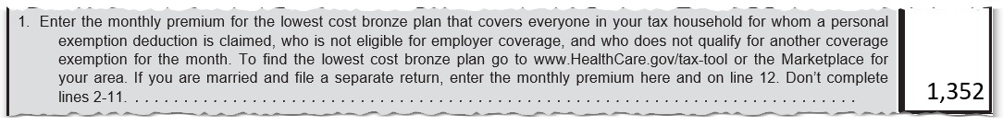
MCA Wkt in Pub 4012
Example
Look up LCBP for Line 1
Both grandparents and the grandchild
Notes:
MCA = Marketplace Coverage Affordability
LCBP = lowest cost bronze plan

Slide 89
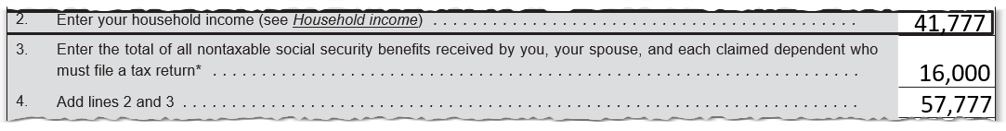
MCA Wkt
Example
Household income A
Add untaxed Social Security
Household income B
Notes:
This is not the affordability threshold, which includes pre-tax medical and does NOT include untaxed social security

Slide 90
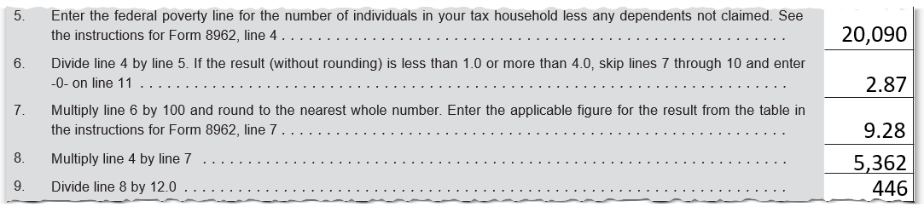
MCA Wkt
Example
Look up FPL
Look up applicable percentage
Do arithmetic
Notes:
FPLs are on Pub 4012 p. ACA-12
Applicable percentages may be added to Pub 4012, if not, look at instructions to F 8962

Slide 91
MCA Wkt
Pub 4012 ACA-11
Line 10 – SLCSP* cost for persons that can get insurance only in the individual market and not otherwise exempt
  EXCLUDES family members that have or eligible for government-sponsored coverage
    e.g. Medicare, Medicaid, CHIP, VA or TRICARE
  Use sum of fewest number of silver plans possible if one policy cannot cover all persons
*Second-lowest-cost silver plan
Notes:
You may need to determine whether an individual is actually eligible for Medicaid.
Ask the taxpayer or look on Medicaid.gov for your state and county as income limits may be higher than 138%, especially for children under age 19 or pregnant women
Generally for Expansion states:
When the household MAGI (increased for untaxed social security benefits) is above 138% of the federal poverty line, the tax family is not eligible for Medicaid and is eligible for a PTC. Line 10 SLCSP will include all the individuals that do not have an employer offer.
When the household MAGI (increased for untaxed social security benefits) is below 138%, the tax family would have been eligible for Medicaid and not eligible for PTC. In this case, Line 10 SLCSP will be zero.
Generally for Non-expansion states:
When the household MAGI (increased for untaxed social security benefits) is above 100% of the federal poverty line, the tax family is not eligible for Medicaid and is eligible for a PTC. Line 10 SLCSP will include all the individuals that do not have an employer offer.
When the household MAGI (increased for untaxed social security benefits) is below 100% of the federal poverty line, the tax family would have been eligible for Medicaid and would therefore not be eligible for the PTC. In this case, Line 10 SLCSP will be zero.
Tip: When the household MAGI (increased for untaxed social security benefits) is 0% to 138% of FPL and the tax family lived in a non-expansion state during any part of the year and did not have minimum essential coverage, use code G exemption for the whole year – the affordability calculation/exemption is not needed.

Slide 92
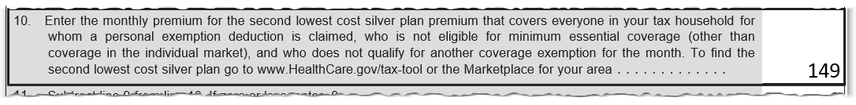
MCA Wkt
Example
Look up and enter SLCSP on Line 10:
Grandchild only

Slide 93
MCA Wkt
Individuals included in Line 1 can be different than those in Line 10!

Slide 94
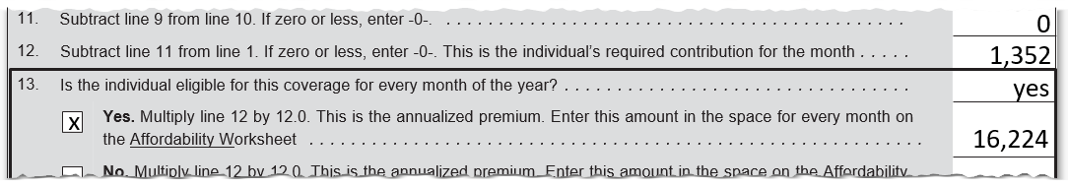
MCA Wkt
Example
Complete lines 11, 12 and 13
Compare to affordability threshold of 8.13% of $41,777 or $3,396
Notes:
Exemption met for all months in this example
Remind class that affordability threshold (slide 71) does not include untaxed social security, but would include pre-tax medical

Slide 95
Marketplace Coverage Affordability Exemption
When annualized cost (line 13 of MCA Worksheet) is greater than affordability threshold
  exemption applies
  to those included in line 1 that need the exemption
Notes:
Exemption met for all months in this example

Slide 96
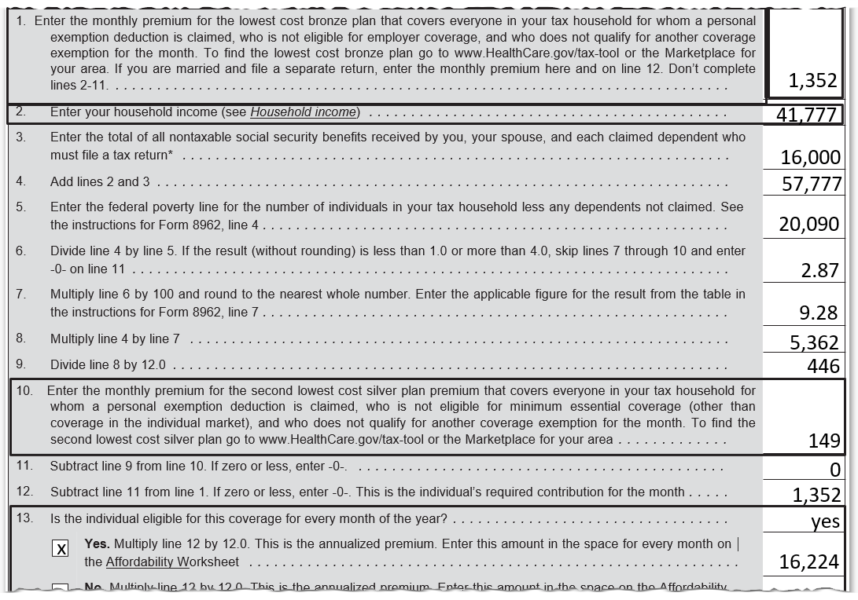
MCA Wkt
Example
Grandchild can claim the exemption; grandparents don’t need an exemption
Notes:
This is the full worksheet

Slide 97
Affordability Calculator
cotaxaide.org/tools
Great tool – if used properly
Read all instructions carefully and be careful with coverage quote lookups
Notes:
A world of thanks to Jeff Bogart!

Slide 98
Affordability Example:
Tommy
Tommy, age 27 on 1/1/2016, lives in an expansion state, no coverage all year (paid SRP for all of 2015)
Worked Jan and earned $2,000
  Employer offered coverage at $95/ mo
Unemployed Feb – Oct and got $8,200 of unemployment income
  Eligible for Medicaid, but did not apply
Worked Nov – Dec and earned $5,000
  Employer coverage starts Jan 2017
MAGI = $15,200

Slide 99
Affordability Example:
Tommy
No Marketplace exemption
Above the filing threshold
A citizen of the U.S.; not in a health care sharing ministry; not a member of an Indian tribe; not incarcerated
Only possible exemptions
  Affordability
  Short gap

Slide 100
Affordability Example:
Tommy
Preliminary assessment:
  Affordability for Jan – measured against employer offer (Tommy may have brought in a 1095-C with the information or he otherwise said how much it would have cost him)
  Affordability for Feb – Oct measured against LCBP with no PTC because Tommy was eligible for Medicaid; LCBP is $175 / mo
  Affordability for Nov – Dec measured against LCBP net of PTC (not eligible for Medicaid with new job); LCBP is $175 / mo, SLCSP is $226 / mo
Notes:
Medicaid eligibility may have a 45-day waiting period before eligibility – for this example, assumed that Medicaid eligibility started in February (could have lost his job early Jan)
Medicaid eligibility may really continue until the next evaluation date
For purposes of this example, it is assumed that Tommy was not eligible for Medicaid at all in November and December

Slide 101
Affordability Example:
Tommy
Compute Tommy’s affordability threshold: $15,200 x 8.13% = $1,237
Jan – employer offer $95 x 12 = $1,140
Employer offer was affordable for January
Notes:
Emphasize to always use annual amounts

Slide 102

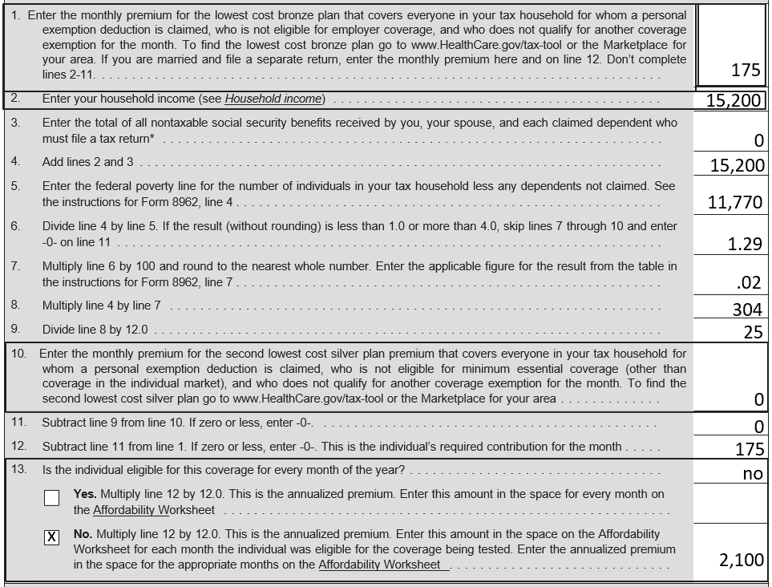
MCA Wkt for Tommy: Feb - Oct
L 1: LCBP
L 10: No SLCSP – Tommy was eligible for Medicaid

Slide 103
Affordability Example:
Tommy
Feb - Oct – MCA Wkt $2,100
Compare to Tommy’s affordability threshold: $15,200 x 8.13% = $1,237
Marketplace coverage was unaffordable for Feb - Oct
Notes:
Emphasize to always use annual amounts

Slide 104
Result for Tommy
January – affordable employer offer, look back to 2015 and gap is 3 months or more so cannot claim short-gap
  Could ask for a hardship exemption from Mkt
  Last option: pay SRP for 1 month
Feb – Oct – marketplace coverage was not affordable – get the exemption
Nov – Dec – 1st gap of the year of less than 3 months so can get the short gap exemption
Notes:
Highlight that prior November and December were gap months as no coverage and no exemption.

Slide 105
Last Chance Exemption
Pub 4012 ACA-7
If none of the tax return exemptions applies…
Taxpayer can review whether a Marketplace hardship or other exemption might apply – See 4012 ACA-7
If so, they need to apply a.s.a.p.
Use “PENDING” for the ECN
Remind taxpayer that IRS follows up on all pending exemptions
Notes:
Some people who have limited-benefit Medicaid, which is not MEC, may be eligible for a Marketplace exemption
Some Marketplace exemptions are retroactive; some are prospective
Market-granted affordability exemption is prospective only

Slide 106
Last Chance Exemption
Exemption application forms:
  Marketplace.cms.gov
  For Connecticut only:
  www.accesshealthct.com/AHCT/jsp/frontend/feiam/IndividualExemptionApplication.pdf
Notes:
Emphasize: counselors are not expected to complete the application for taxpayers
Counselors may print out the application (which has to be mailed in with documentation) for the taxpayer, if approved by LC

Slide 107
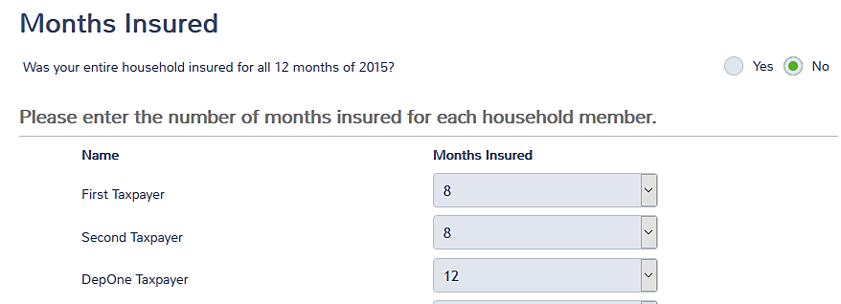
Indicate Months of
Coverage
For each Person on the return, indicate the months they have coverage
Notes:
Previously showed how to indicate that everyone had coverage all year

Slide 108
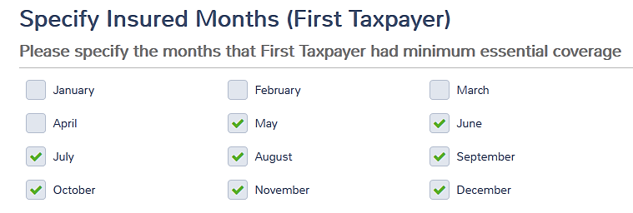
Indicate Months of
Coverage
For each Person on the return, indicate the months they have coverage
Notes:
Previously showed how to indicate that everyone had coverage all year

Slide 109
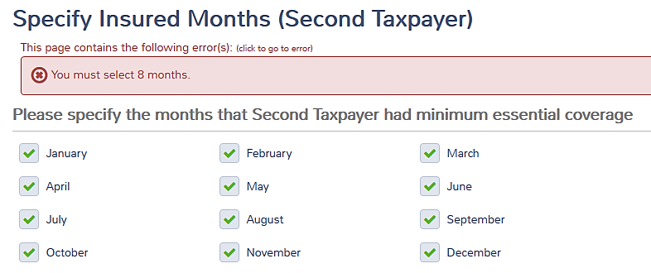
Indicate Months of
Coverage
Two prior screens must match or get error message
We said Second Taxpayer had 8 months of coverage, not 12
Notes:
Previously showed how to indicate that everyone had coverage all year

Slide 110

Exemptions in TaxSlayer
Need to have answers first, then enter in TaxSlayer
Note the “or” – answer yes if there is ANY exemption

Slide 111
Exemptions in TaxSlayer –
Filing Threshold
May not need to enter again (see slide 45)
Household income
  Enter dependents’ MAGI if they must file a return due to gross income
Will check the box if it applies

Slide 112
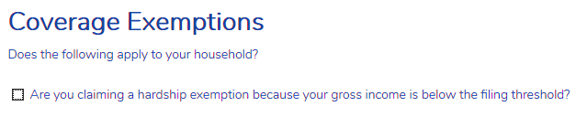
Exemptions in TaxSlayer
Filing Threshold
Check box for filing threshold exemption
Don’t confuse with Mkt hardship exemptions
Notes:
As previously noted, the Counselor will need to compute the gross income for the return

Slide 113
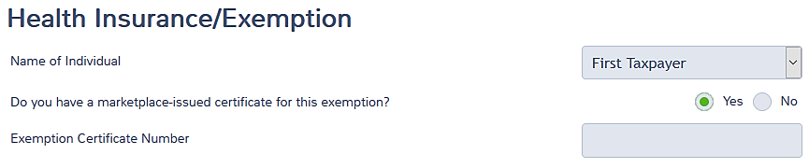
Claiming an Exemption
For each Person on the return, is there a Mkt exemption
If so, enter the ECN
Use PENDING if not received yet

Slide 114
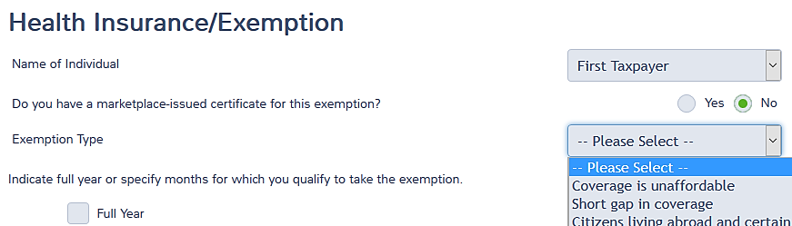
Claiming an Exemption
If not a Mkt nor filing threshold exemption, which one?

Slide 115
Claiming an Exemption
(Form 8965 Part III)
For each Person on the return, indicate exemption being claimed
Also check full year or months for which exemption is claimed
Can have more than one exemption per Person

Slide 116
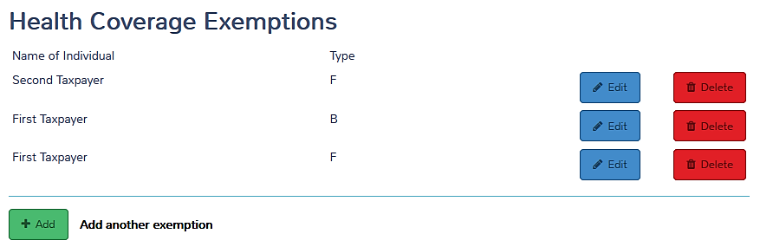
Claiming an Exemption
(Form 8965 Part III)
Add more until all exemptions needed are listed

Slide 117
Claiming an Exemption
Reminder – need to know which exemption(s) to claim for which month(s) for which Person before making entries
Use the Intake form!

Slide 118
Claiming an Exemption
If all months accounted for with coverage or exemption, no SRP
If not, TaxSlayer computes SRP
TaxSlayer exits Health Insurance section

Slide 119

ACA Exemptions
Click Summary/ Print
Is there a Shared Responsibility Payment?
Should there be one?
Notes:
SRP is the next topic

Slide 120
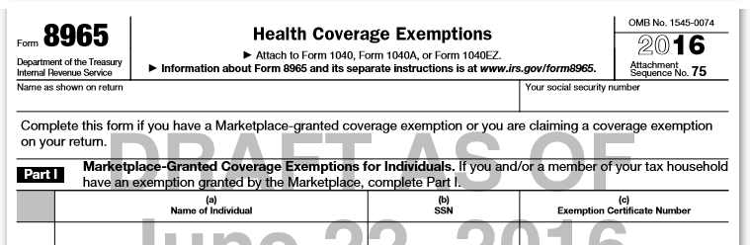
Exemption Form 8965
Confirm exemptions show on Form 8965 as intended
Notes:
Instructions for form 8965 provide detailed information for completing the form

Slide 121
No Insurance, No Exemption?
Individual Shared Responsibility Payment (ISRP or SRP) is paid with tax return
  2014 small penalty
  2015 bigger penalty
  2016 even bigger penalty
  Adjusted thereafter
SRP is core, but when SRP applies the Reviewer must have comprehensive training to assure that no exemption applies
Notes:
Almost 3% of 2015 returns prepared by Tax-Aide paid SRP – on average, $359
General feeling is that too much SRP is being reported!

Slide 122
Shared Responsibility
Payment (SRP)
Pub 4012 ACA-13
Year | Full-year payment is greater of:
2014 | 1% of household income above tax filing threshold (up to cap*) | $95 per adult, $47.50 per child (up to cap of $285)
2015 | 2% of household income above tax filing threshold (up to cap*) | $325 per adult, $162.50 per child (up to cap of $975)
2016 | 2.5% of household income above tax filing threshold (up to cap*) | $695 per adult, $347.50 per child (up to cap of $2,085)
> 2016 | Values increased by a cost-of-living adjustment
* Capped at national average premium of a bronze level plan purchased through a Marketplace. For 2016, the cap is $2,676 per individual ($223 per month per individual), with a maximum of $13,380 for a family with five or more members ($1,115 per month for a family with five or more members).
Notes:
This is not a simple calculation and presented only to show the magnitude of the penalty
Students do not need to know how to calculate the penalty

Slide 123
Household Income for SRP
Taxpayer’s MAGI (including spouse if MFJ)
Add claimed dependent’s MAGI – if dependent is required to file a return due to gross income
MAGI
Adjusted Gross Income
(AGI)
Tax-Exempt Interest
Excluded Foreign Income
=
+
+
Form 1040, Line 37
Form 1040, Line 37
Form 1040, Line 8b
Form 2555 or 2555-EZ
Notes:
A place to enter dependent’s MAGI has been promised – not in PL 2015 as yet.

Slide 124
Dependent Income in TaxSlayer
May not need to enter again (see slide 45)
Need to add all dependents’ amounts from their returns
Notes:
Early TaxSlayer information is that this screen will be earlier in the Health Insurance section.

Slide 125

Example: John (Single)
Income: | $17,000
Filing Status: | Single
Adults: | 1
Children: | 0
Tax Filing Threshold: | $10,350
Months Uninsured: | 12
Notes:
This is merely an illustration of how the calculation works – TaxSlayer does all the arithmetic

Slide 126
Example: John (Single)
Penalty Calculation:
1. $17,000 - $10,350 =
2. $695 x 1 adult =
$6,650
x 2.5%
$ 166
$695
SRP for 2016
Notes:
This is merely an illustration of how the calculation works – TaxSlayer does all the arithmetic
Emphasize that since the penalty is much bigger this year, need to QR the return thoroughly to make sure that no exemption applies – including the TP asking for a marketplace hardship or other exemption!

Slide 127

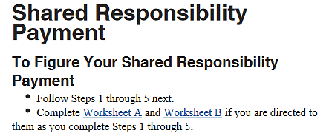
Shared Responsibility
Payment
Use Preview Return
Review SRP worksheet

Slide 128



Affordable Care Act (Day 1)
Comments
Questions

Slide 129
Affordable Care Act
Day 2
Pub 4012 – ACA Tab
Pub 4491 – Lesson 3
Pub 974 – Premium Tax Credit

Slide 130
Premium Tax Credit
Premium Tax Credit (“PTC”) – a refundable credit
  Marketplace estimates PTC at time of purchase
PTC can be paid in advance (“APTC”) to insurance company OR applied as refundable credit on federal tax return
Must be reconciled on tax return
  Must file to reconcile APTC even if not otherwise required to file
  Use Form 8962 using Form 1095-A information
Notes:
Form 1095-A Affordable Insurance Marketplace Statement shows the amount of their premiums and advance credit payments including the premium for the applicable benchmark plans used to compute the credit, the total premium for the coverage of the taxpayer, the advance credit, the SSN and names of all covered and other relevant information.
Form 8962 is used to compute the premium tax credit on the tax return and to reconcile the advance credit payments or credit.
Approximately 3.9% of 2015 Tax-Aide-prepared returns filed 8962 (up from 2.6% for 2014).

Slide 131
PTC Eligibility
For each month:
Must have qualified health plan through Marketplace as of the first day of each month
TP’s share of premiums paid by due date of return
Not eligible for other MEC – includes an offer, even if it was not taken
  Affordable employer coverage
  Government-sponsored coverage
  Other HHS certified MEC
Exceptions apply
Notes:
The Marketplace will make the eligibility determination. TP is responsible for keeping Mkt up to date.
First day of month coverage requirement is met by a child born, adopted or placed in the home for adoption or foster care during the month.

Slide 132
PTC Eligibility
For the year:
Household income within 100% to <401% of FPL
Cannot be claimed as a dependent
Cannot file MFS
Exceptions apply
Notes:
The Marketplace will make the eligibility determination. TP is responsible for keeping Mkt up to date.

Slide 133
PTC Eligibility – Eligible for Other MEC
Pub 974
Normally, cannot claim PTC if eligible for government-sponsored or affordable employer coverage, whether or not enrolled
Except for (can get PTC)
  Transition month(s) when moving from one coverage to another
  Retroactive coverage (e.g. retro Medicaid)
  COBRA or retiree coverage not taken
  Government-sponsored coverage in some cases (see Pub 974)
Notes:
• May be exhibited on Form 1095-A and Form 1095-B or 1095-C with data for the same month(s)
The forms may not be received until the end of March – IRS extended the due date

Slide 134
PTC Eligibility – Eligibility for Other MEC
Can get PTC even though covered by
  Limited coverage Medicaid
  AmeriCorps or AfterCorps (for returning Peace Corps)
  Other coverage that is not MEC
Note: ESI that is unaffordable or does not provide minimum value but is taken anyway is considered MEC for PTC purposes
Notes:
Limited benefits coverage is generally not treated as MEC
There are exceptions – rely on the Mkt for determination of PTC eligibility

Slide 135
PTC Eligibility
If marketplace has granted APTC, persons listed on Form 1095-A are eligible for PTC
We do not second guess!
Notes:
First year is a safe harbor; if TP is not entitled to PTC for all of the second year, loses safe harbor

Slide 136
PTC Eligibility – % of FPL
Household MAGI of at least 100% and less than 401% of FPL
Exceptions
  Actual is <100% AND Mkt estimated that would be in range and granted APTC
    If no APTC, exception does not apply - do not input 1095-A into TaxSlayer
  Legal immigrant ineligible for Medicaid (example, first 5 years)
Notes:
Emphasize: 400.999% is less than 401% - TaxSlayer handles properly.
If 1095-A is input, TaxSlayer automatically computes PTC and applies the cap

Slide 137

PTC % of FPL:
Alaska or Hawaii
If taxpayer or spouse lived in Alaska or Hawaii during 2016
  Use higher FPL on PTC form
  Use Resident State field on Personal Information screen

Slide 138
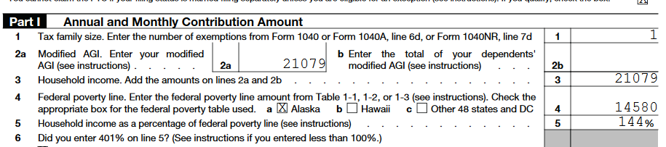
PTC % of FPL :
Alaska or Hawaii
Confirm on Form 8962

Slide 139
PTC Eligibility – MFS
Cannot file MFS status (HoH is ok)
Exceptions
  Abused spouse living apart from spouse and cannot file jointly due to abuse
  Abandoned spouse unable to locate spouse after due diligence
Notes:
See exceptions for MFS in Pub 8962 instructions for victims of domestic abuse or spousal abandonment See pub 974 for documentation that the TP should retain

Slide 140
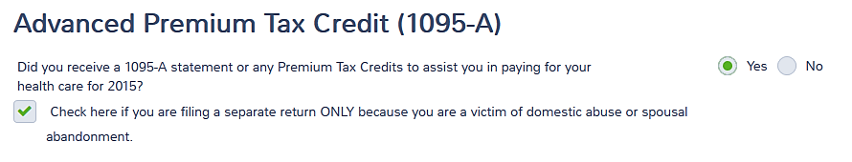
PTC Eligibility – MFS
Exception
TaxSlayer will ask in an MFS return
Maximum is 3 years of relief
Notes:
See pub 974 for documentation that the TP should retain

Slide 141

PTC Eligibility – MFS
Exception
Confirm exception is checked on top of Form 8962
Notes:
See pub 974 for documentation that the TP should retain

Slide 142
PTC Eligibility – Family Glitch
Pub 974
An employee’s tax family member is ineligible for PTCs if member is offered coverage and self-only coverage is affordable – example:
  Employee coverage is affordable, so children in the tax family are ineligible for PTC
  If no spousal ESI offer, spouse is eligible for PTC
  Employee-only offer at 6% of income
Employee and children offer at 10% of income
Notes:
If there is no offer of coverage, e.g. no spousal coverage offer, then the affordability test does not apply to the spouse
If the family member is not claimed as a spouse or dependent on the employee’s tax return, the offer of ESI does not make the individual ineligible for PTCs – the family member must be a TAX family member

Slide 143
PTC Eligibility
If marketplace has granted APTC, persons listed on Form 1095-A are eligible for PTC
We do not second guess!
We compute the final amount of PTC based on the final 2016 income
Notes:
Employee safe harbor rule –
Mkt determines that employer plan is unaffordable
Even if the employer plan turns out to be affordable based on actual household income, employee remains eligible for PTC
If affordable all of the second year, loses the safe harbor

Slide 144
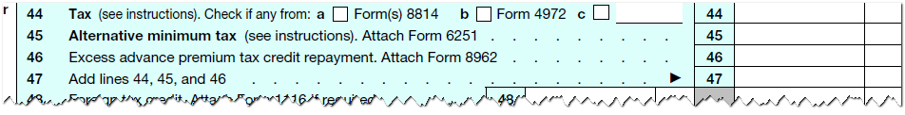
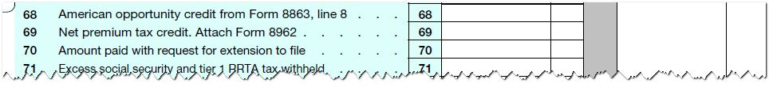
PTC End Result: Form 1040
Repay excess credit – line 46
or claim more credit – line 69
Notes:
Line 46 – any net negative PTC (i.e. income that the end of the year resulted in an excess of PTC during the year) is entered on this line.
Line 69 – any net positive PTC (i.e. income at the end of the year resulted in more PTC than was originally claimed) is entered on this line

Slide 145
Calculation of PTC
Pub 4012 ACA-14
Final amount of PTC is computed on Form 8962
  Need Form 1095-A
    Monthly premium amount
    SLCSP (second lowest cost silver plan)
    APTC
Need household income
TaxSlayer then computes the credit

Slide 146


Form 1095-A
1095-A Void box checked
  It is voiding a previously issued 1095-A
  Do not use the voided 1095-A nor the 1095-A previously received
1095-A Corrected box checked: use the 1095-A that is marked corrected
If another taxpayer enrolled someone in TP’s tax family, need a copy of that 1095-A

Slide 147
What determines the amount of PTC?
Based on income and family size, the taxpayer’s contribution for coverage is computed (the amount they’re responsible for)
The credit is the SLCSP less the contribution, but not to exceed the actual premium on a monthly basis

Slide 148
What is Household Income for PTC?
MAGI for the taxpayer (and spouse if MFJ)
Plus
  MAGI of any individual claimed as a dependent and who is required to file a federal income tax return due to gross income
Having to file for self-employment tax does not count!

Slide 149
Different Definitions of MAGI
Modified Adjusted Gross Income is AGI Plus:
PTC
Tax-exempt interest
Untaxed Social Security benefits*
Untaxed foreign earned income**
Exemptions/SRP
Tax-exempt interest
Untaxed foreign earned income**
* Includes untaxed lump-sum benefits received in 2016 and untaxed tier 1 RR
** Form 2555 Lines 45 + 50; or Form 2555-EZ Line 18
Notes:
For lump-sum social security benefits, complete the lump-sum worksheet as normal
TaxSlayer will add the untaxed portion
For dependents with a filing requirement, include the untaxed portion of a lump-sum benefit

Slide 150
Household Income for PTC
TaxSlayer computes the MAGI for the taxpayer
Preparer needs to determine:
  Whether a dependent has to file a return
  If so, the amount of dependent’s MAGI for PTC purposes (including untaxed SS)

Slide 151
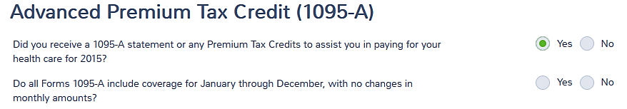
Entering 1095-A Data
Need 1095-A

Slide 152
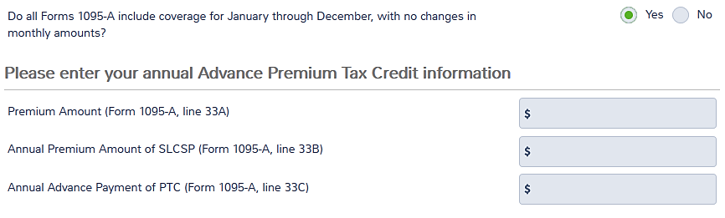
Entering 1095-A Data
Checking that months are the same opens annual fields

Slide 153
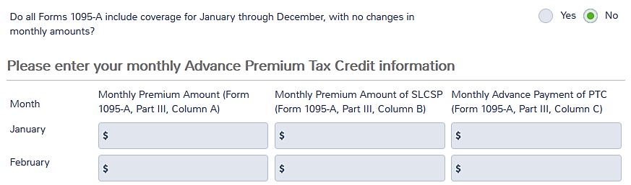
Entering 1095-A Data
Checking that months are different opens monthly fields

Slide 154
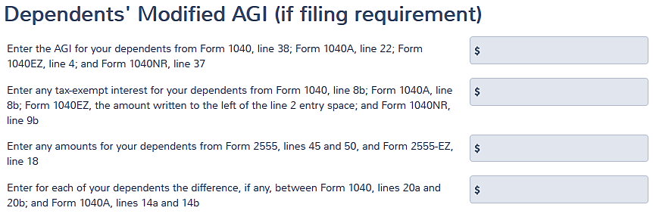
Completing PTC in TaxSlayer
May not need to enter again (see slide #45)
Need dependents’ returns
Notes:
This screen will move up in the sequence.

Slide 155
PTC in TaxSlayer
Copy data from 1095-A into TaxSlayer input form
  Annual totals if all months are the same
  Monthly amounts if not
  Hint: Ctrl-C on field to copy contents and use Ctrl-V to past down each month

Slide 156
PTC Calculation –
Missing Info
Form 1095-A does not have a SLCSP amount or has an incorrect SLCSP amount
Taxpayer can contact the Marketplace for the missing information
Preparer can look up the SLCSP with the fewest number of policies possible using the ages at the beginning of the year
Notes:
Instructor should show how to look up 2016 quotes on Healthcare.gov or the state exchange
TPs should have the Mkt correct other errors, e.g. SSNs, but no need to delay filing the return

Slide 157
PTC Calculation –
Missing Info
Moved?
  Need to look up on a monthly basis
A person on the return lived in another zip code/city?
  Look up separately
Notes:
SLCSP may not be correct if TP failed to notify the Mkt of changes to composition of coverage family, their eligibility for MEC (other than the individual market) or if they moved

Slide 158
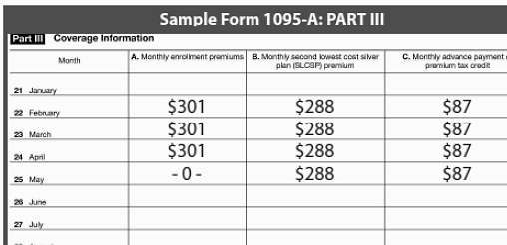
PTC Calculation – Premium Not Paid
The premium must be paid by the due date of the return to claim PTC
When taxpayer stops paying, there is one month that 1095-A will show as zero
Notes:
If there is more than one month with column A blank, there is a mistake. TP should follow up with Mkt to get a corrected 1095-A for their files (and the IRS’s files).

Slide 159
PTC Calculation – Premium Not Paid
Taxpayer not eligible for PTC for that month
Taxpayer does have coverage for that month
  No exemption is needed.

Slide 160
PTC Calculation – Premium Not Paid
Taxpayer may be better off paying the premium they are responsible for
  PTC repayment may be greater
  Need to get a corrected 1095-A
    Can file return now; no need to wait

Slide 161
PTC Calculation –
Multiple Policies
Two or more individuals of the same tax family in the same zip/city are enrolled in different Mkt policies
Can add up the actual cost of their coverage (1095-A column A)
Can add up the reported amount of APTC (1095-A column C)
Cannot add up the SLCSP quotes (1095-A column B)
Notes:
The column A amounts will be for essential health benefits and will be adjusted by the Mkt to include pediatric dental coverage and exclude nonessential benefits, e.g. adult dental
Cannot merely add the SLCSP amounts shown on the 1095-A
Instructor should show how to look up 2016 quotes on Healthcare.gov or the state exchange

Slide 162
PTC Calculation –
Multiple Policies (cont.)
Need to look up the SLCSP quote using the ages at the beginning of the year
Use fewest number of policies possible
Can add up the SLCSP in some cases (e.g. pre-marriage months)
See Pub 974 or 8962 instructions for more details
Notes:
Cannot merely add the SLCSP amounts shown on the 1095-A
Instructor should show how to look up 2016 quotes on Healthcare.gov or the state exchange

Slide 163
PTC Calculation –
Multiple Policies (cont.)
When taxpayer moves (particular from one state to another) they will have multiple Marketplace policies
In that case, add the SLCSP amounts from the 1095-A month by month and enter in TaxSlayer (do not recompute)
See Pub 974 or 8962 instructions for more details

Slide 164
PTC Calculation – Ineligible Individual on Policy
Form 1095-A may include coverage for an ineligible individual
May need to get new quotes for both the actual plan cost and the SLCSP
Check with site manager whether return will be prepared at your site
See Pub 974
Notes:
If APTC was granted with respect to the unlawfully present individual, the entire APTC for that person must be repaid – no cap
Lawfully present coverage family members’ APTC repayment (if any) can be capped

Slide 165
PTC Calculation – Ineligible Individual on Policy
Examples
  An unlawfully present dependent on the same policy as a lawfully present taxpayer
  An individual that was eligible for government-sponsored coverage but was included in the Marketplace policy for the same month (e.g. Medicare)
See Pub 974
Notes:
Usually, PTC cannot be claimed for a month later than the month after government coverage is approved.
If government coverage is granted retroactively, PTC can still be claimed until the month following the coverage determination

Slide 166
PTC Calculation – Unclaimed Individual (special situation)
When APTC has been given by the Marketplace for an individual AND
That individual does not claim their own exemption deduction AND
No one else claims the individual as a dependent, THEN
The person that enrolled the individual is responsible for reconciling the APTC
Notes:
TP cannot claim PTC for a nondependent
Result is that all APTC will need to be repaid as not a member of the tax family

Slide 167
PTC Calculation – Unclaimed Individual (special situation)
Possible situation:
  Child lives with three different relatives during the year; each less than 6 months
  Most of the child’s support is provided by the state (e.g. public assistance)
  No relative can claim the child – not a qualifying child (resided together <6 months) nor qualifying relative (provided <½ of support)
  (Continued next slide)

Slide 168
PTC Calculation – Unclaimed Individual (special situation)
Possible situation (cont.):
  If one of the relatives enrolled the child in a Marketplace policy with APTC, they must reconcile the APTC on their return, even though they cannot claim the child
  No PTC allowed for a nondependent
Notes:
Child would likely have been eligible for CHIP and marketplace should have denied APTC, depending on how the questions were answered

Slide 169
Final PTC
Based on final tax return data
Final PTC may be more than the Advance PTC (“APTC”)
  Claim a credit on the 1040
Final PTC may be less than the APTC
  Pay back the excess (may be capped)

Slide 170
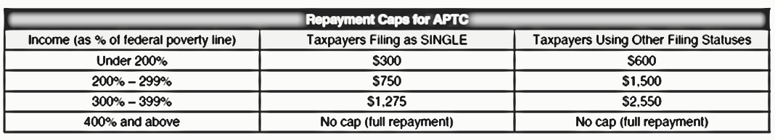
Repayment of
Excess APTC
Pub 4012 ACA-18
Cap on repayment is based on Household MAGI* as a % of FPL
Full repayment if ≥ 400% FPL
No rounding of percentages!
*PTC definition
Notes:
The 400% is exact; anything less than 400% is not 400%
For example 399.8% is not 400%
Form instructions say to use 401 for anything over 400 on 8962 line 5, so tax form simply show 401 (not the actual % of FPL)

Slide 171
Last Minute Planning –
Watch for Cliff Hangers
If it appears the taxpayer is near a benchmark income level, consider possible ways to reduce AGI
  Household income is 200%, 300% or 400% of FPL
Consider: deductible IRA (including a recharacterization of a Roth IRA to a traditional IRA), tuition & fees deduction, etc.
Hint: test to see which education benefit is better after entering all return and ACA data

Slide 172
Last Minute Planning – Scholarships / Grants
The student may elect to treat some or all of their grant as taxable income to increase an allowable education deduction or credit
When taxable, the grant is considered earned income for the gross income test of filing requirement
Once a filing requirement exists for the student, the student’s MAGI may have an ACA impact on the taxpayer’s return (e.g. parent’s return)
Notes:
The test to see which education benefit is better includes the use of scholarships or grants to pay qualified education expenses (the grant is excluded from income) or to pay for other expenses, such as room and board. The latter situation may create a filing requirement for the student and there may be ACA implications.

Slide 173
Last Minute Planning
If it appears MFJ taxpayers are having to repay a lot of APTC (e.g. at 450% of FPL)
  Consider MFS status
  They are no longer eligible for PTC
  BUT the repayment cap may apply!
MFS status may also help in the year of marriage instead of the alternative calculation, which is out of scope
Refer to 8962 instructions
Notes:
If both spouses are on a single policy, each is allocated 50% of the APTC (TP cannot elect a different percentage) – see 8962 instructions
Must complete the shared allocation (Part IV) to show only 50% claimed and the SSN of the other spouse
Will need to look up the proper SLCSP if any PTC can be claimed, e.g. one spouse is able to claim HoH or is abused/abandoned
They are not allowed PTC, but the cap can apply to the APTC that must be repaid

Slide 174
PTC and Medical Insurance Itemized Deduction
The itemized deduction for 2016 is
  Decreased for any additional PTC that is claimed on the 2016 return
  Increased for any excess APTC that must be paid back with the 2016 return

Slide 175

PTC and Medical Insurance Itemized Deduction
For a return with PTC and itemizing deductions, go to
Increase or decrease insurance deduction by excess PTC or additional PTC
Make a note on the intake form for TP and reviewer

Slide 176
ACA – Scope Limitations
Pub 4012 ACA-19
Form 8962, Part IV: Shared policies
  A Marketplace policy that covers individuals that are not on the same tax return
  Examples:
  A recently divorced couple on one Mkt policy
  Child covered in Mkt policy with one divorced parent but claimed by the other
  Child covered on parent’s Mkt policy moves out and claims own exemption

Slide 177
Intake & Interview 13614-C
A “no” answer on 3b means there’s a shared policy (but this is not the only test)

Slide 178
ACA – Scope Limitations
Pub 4012 ACA-20
Form 8962, Part V: Alternative Calculation for Year of Marriage
  See 5 questions in Pub 4012, p. ACA-20
  Applies only when there is a Marketplace policy(ies) and there is excess APTC*
  If tentative 8962 shows additional PTC, alternative calculation does not apply and return is in scope*
  *8962 instructions worksheet 3
Notes:
Example: separately, one or the other was eligible for PTC but together are over 400% FPL.

Slide 179
ACA – Scope Limitations
Self-employed individual’s health insurance adjustment to gross income remains out of scope
  (greatly complicated if PTC is involved)

Slide 180
Advance PTC
1. Roger's APTC is $2,400. He is single with no dependents, and lives in Mississippi. His household income is over 400% of the FPL for a family size of one. How much of his APTC will he have to repay with his tax return?
    A $0
    B $1,000
    C $1,400
    D $2,400
Answer: D – Because Roger's household income is over the 400% FPL, his additional tax liability is not capped by the additional tax limitation table

Slide 181
PTC
2. Judy is single with no dependents
In December 2015, Judy enrolled through the Marketplace in a qualified health plan for 2016
On July 14, 2016, Judy enlisted in the Army and was immediately eligible for government sponsored minimum essential coverage
For what period is Judy able to claim a premium tax credit (if she meets all of the eligibility criteria)?

Slide 182
PTC (cont.)
2. (continued)
A - The entire year
B - January through June
C - January through July
D - Judy is not eligible for the premium tax credit
Answer: Judy is eligible for PTC for July assuming she paid her premium for July (and did not get a full premium refund) because her government-sponsored coverage was not in effect on July 1
Notes:
Judy would ineligible for PTC starting with the first full month of government coverage, August – Pub 4491, p. 3-11 TIP
If Judy got a partial month refund for July, would still be eligible for PTC since she is eligible on July 1

Slide 183
PTC
3. Piper’s income is 300% of the FPL for her family size. For this tax year, she purchased health insurance through her employer. Is she eligible to take the premium tax credit for herself?
Answer: No – the coverage must have been purchased through the Marketplace to claim PTC

Slide 184
PTC
4. Patrick is single and has no dependents
In November 2015, Patrick estimated his 2016 household income to be $27,825 and he enrolled in a Marketplace qualified health plan
The Marketplace determined he was eligible for advance payments of the premium tax credit, but he decided to claim the credit on the return
Patrick began a new job in August 2016 and became eligible for affordable employer-sponsored coverage on September 1st
(continued next slide)

Slide 185
PTC (cont.)
4. (cont.) Is Patrick eligible for the premium tax credit?
Answer: Since Patrick became eligible for affordable employer-sponsored coverage in September, he is eligible for a premium tax credit from January through August of 2016* only (if otherwise eligible)
* See instructions if income falls below 100% FPL

Slide 186
PTC
5. Harry purchased insurance through the Marketplace. What documentation will he receive to prepare his tax return?
Answer: He will receive Form 1095-A

Slide 187
PTC
6. Changes in circumstances that can affect the amount of the premium tax credit include:
A - Decrease in household income
B - Marriage
C - Birth of a child
D - Losing employer-sponsored health care coverage and buying Marketplace coverage
E - All of the above

Slide 188
ACA Summary
Taxpayers are responsible for MEC for themselves and their dependents
The preparer can help determine if the taxpayer can claim an exemption, if needed
If taxpayer doesn’t have MEC and doesn’t have an exemption, they owe a SRP

Slide 189
ACA Summary
If taxpayer buys their coverage in the Marketplace, they may be eligible for PTC and may get APTC to help pay the premiums
The Mkt will determine their eligibility for PTC
The preparer can help the taxpayer determine whether they remained eligible and compute the final PTC amount

Slide 190

Updating Information
Taxpayer should notify the Marketplace
  Changes in household Income
  Changes in household
    Marriage or divorce
    Birth, adoption or death
  Eligibility for other programs
The Marketplace can adjust advance payments
Notes:
Updates during the year are key so that there isn’t a large difference in the PTC at the end of the year.

Slide 191
Filing Returns
Taxpayers who get APTC must file tax returns and reconcile their APTC
If they don’t, e.g. failed to file for 2015, may lose APTC in 2017
  Up to the Marketplace
Encourage taxpayers to file all returns as required

Slide 192
Affordable Care Act
Comments
Questions

